Slide 1

Thermal Test Loop Overview
Optional subhead

Slide 2
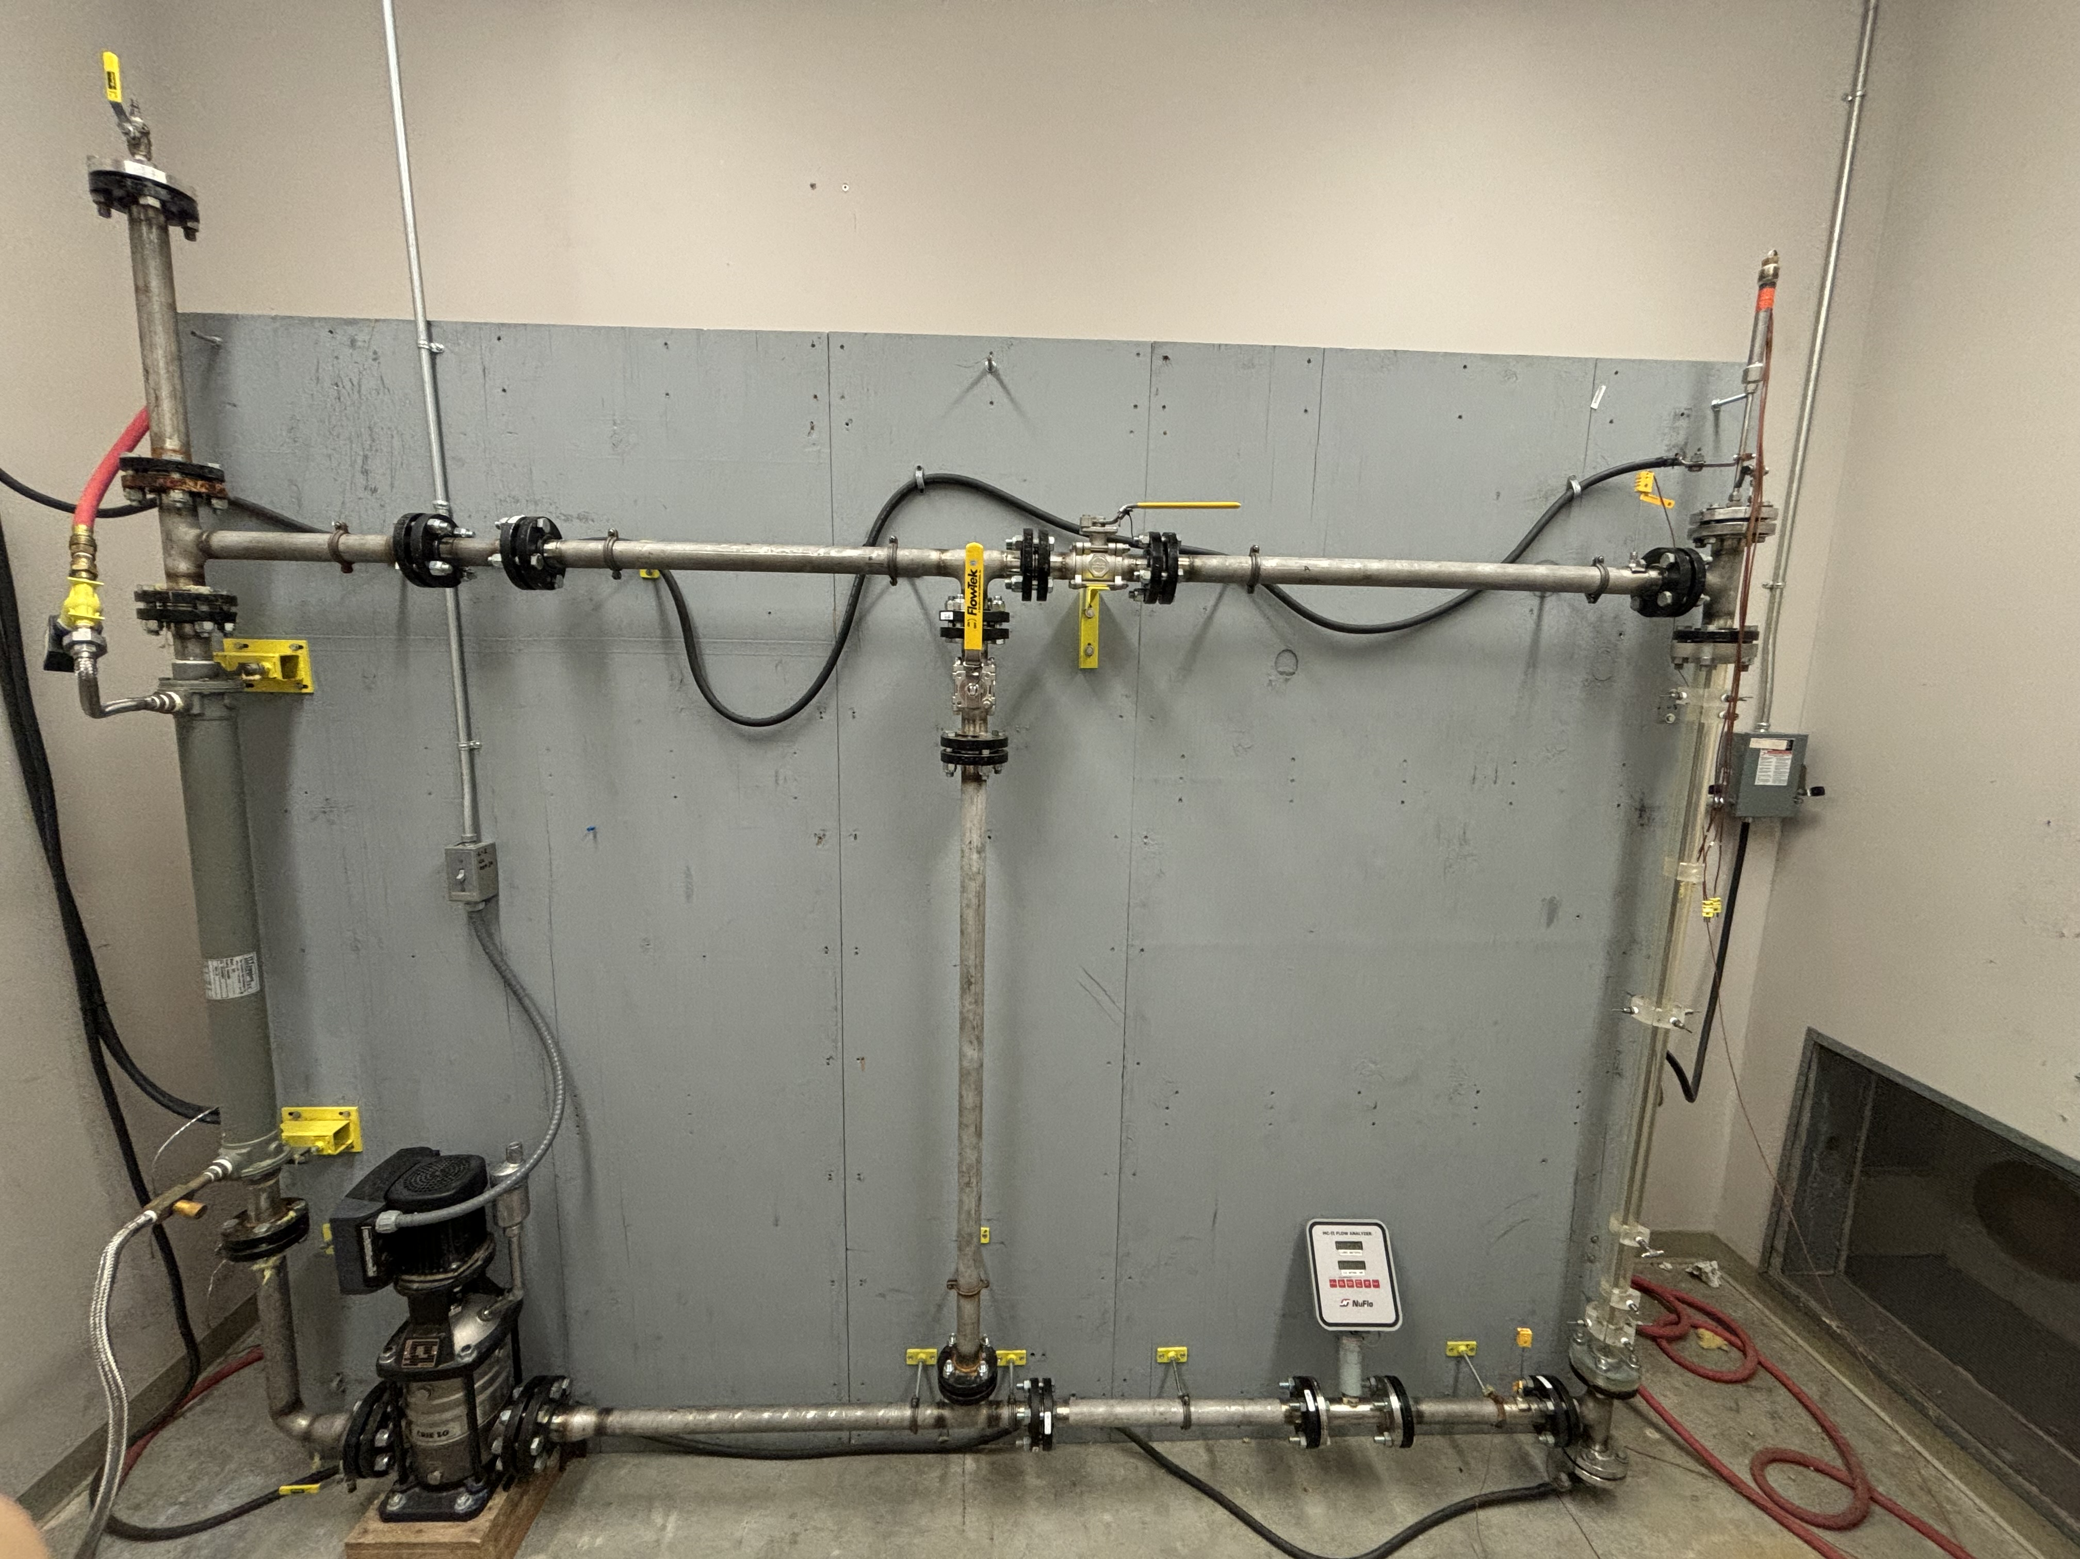
Current Setup
C004g @ 300 main
Closed Loop
Developed first by Dr. Leo Carrilho in *2005*

Slide 3
Component Breakdown

Slide 4
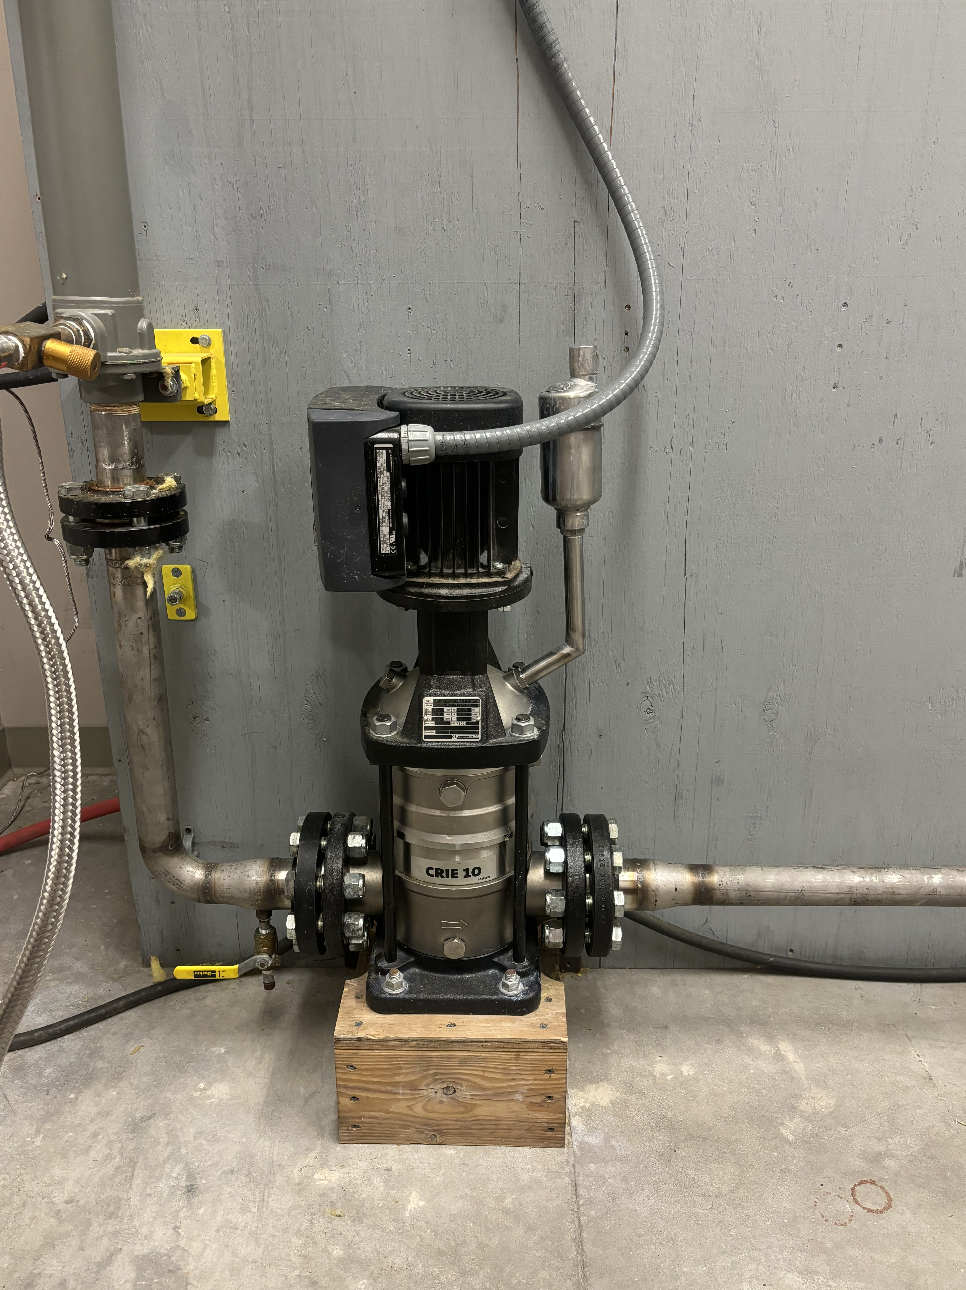
Fluid Pump
Bullet number one
A second bullet
A final, third bullet

Slide 5
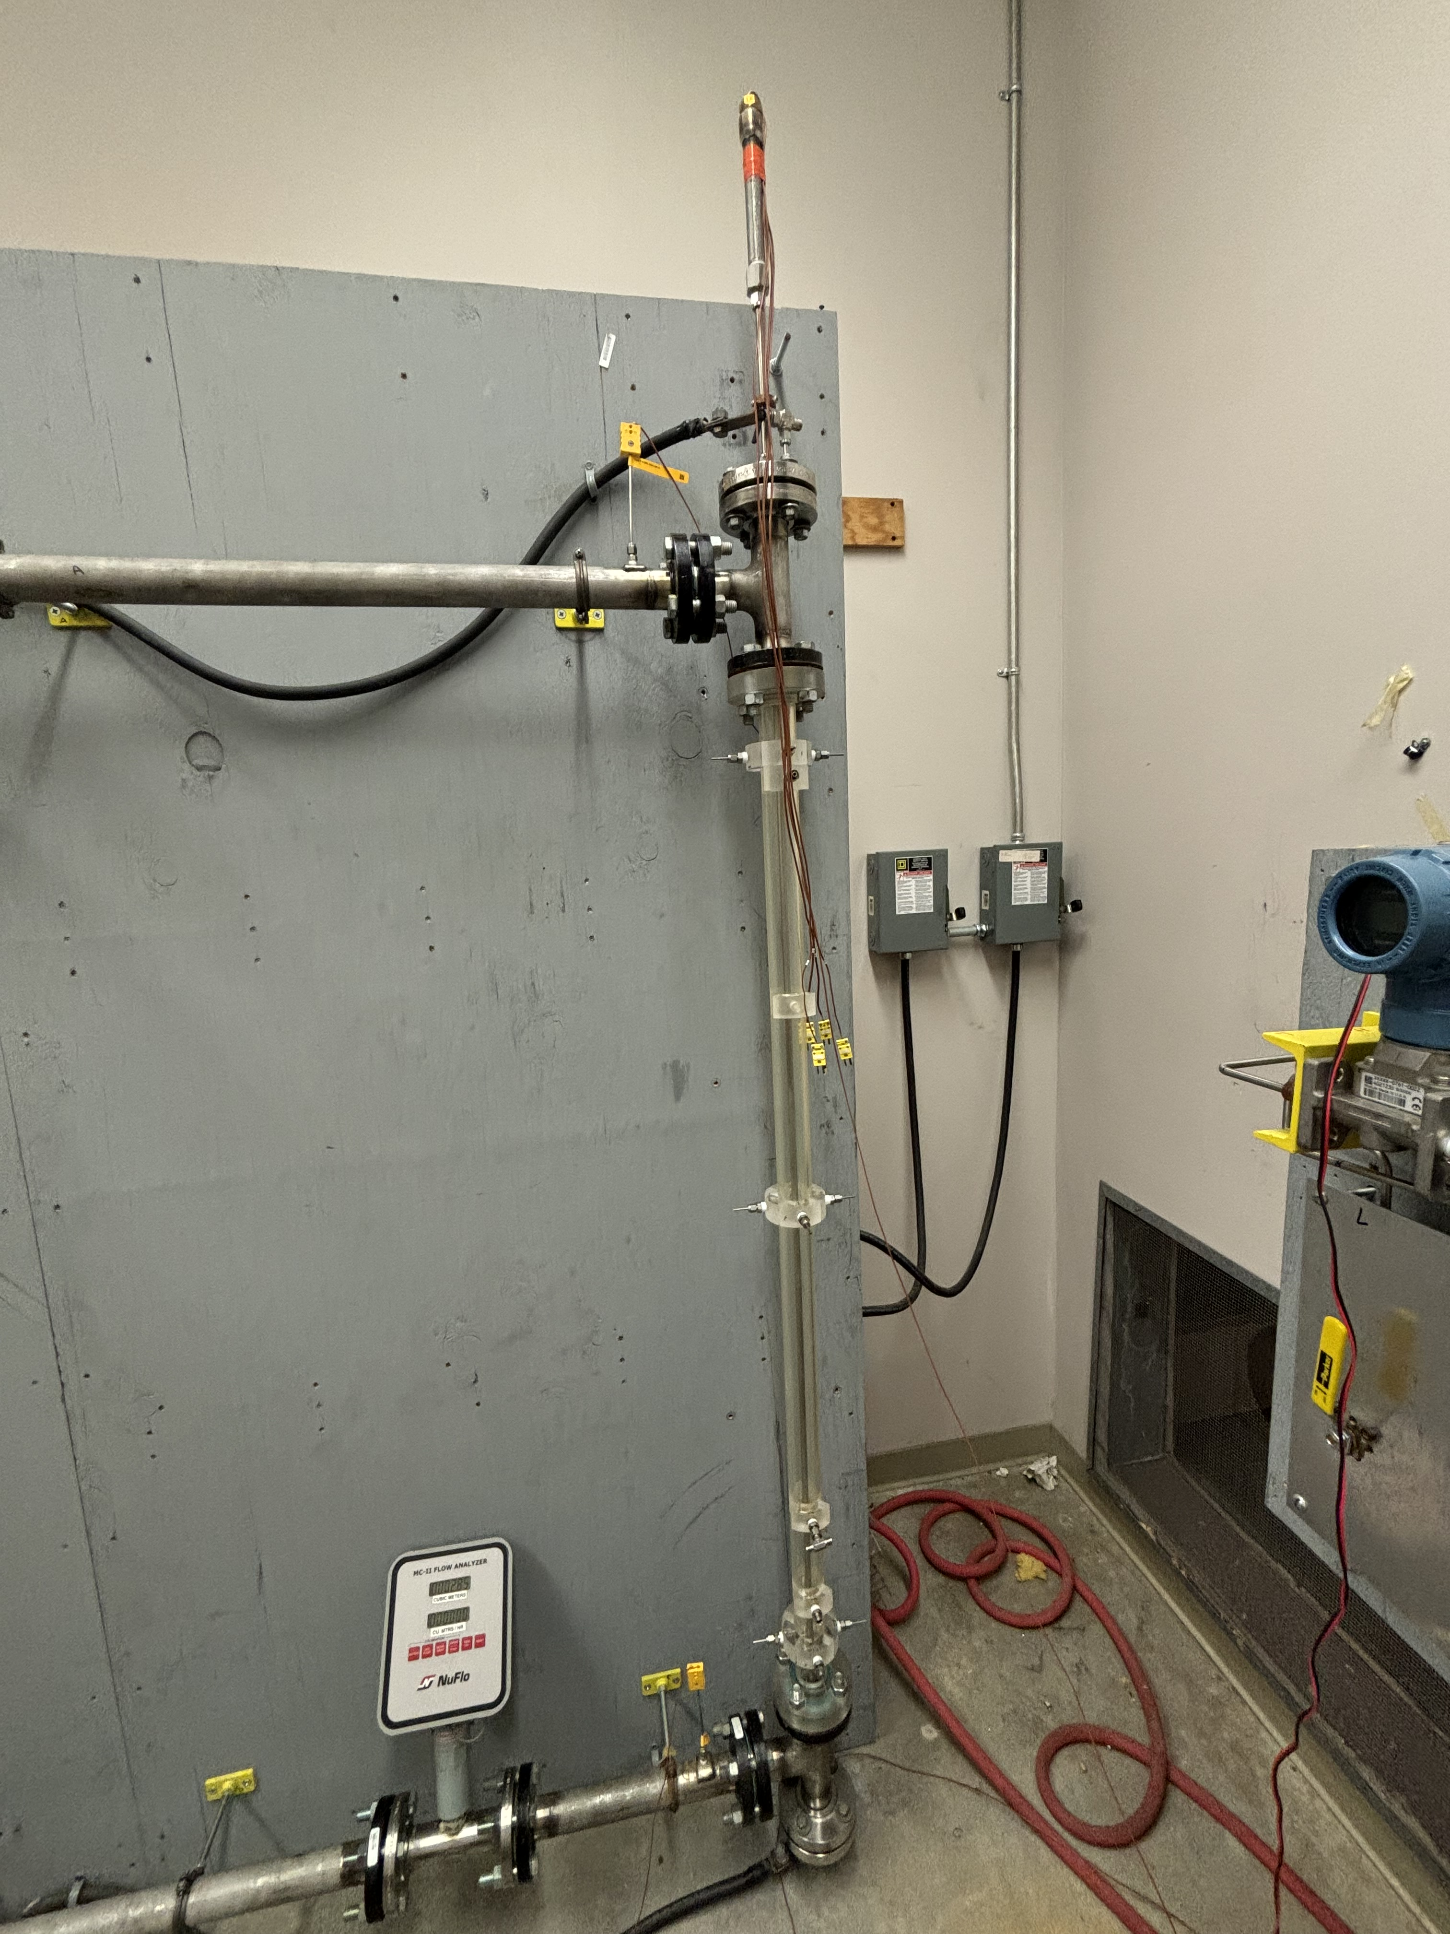
Energy Source- 'Reactor vessel'
Electric heating adds energy to water
Relief valve located on top

Slide 6
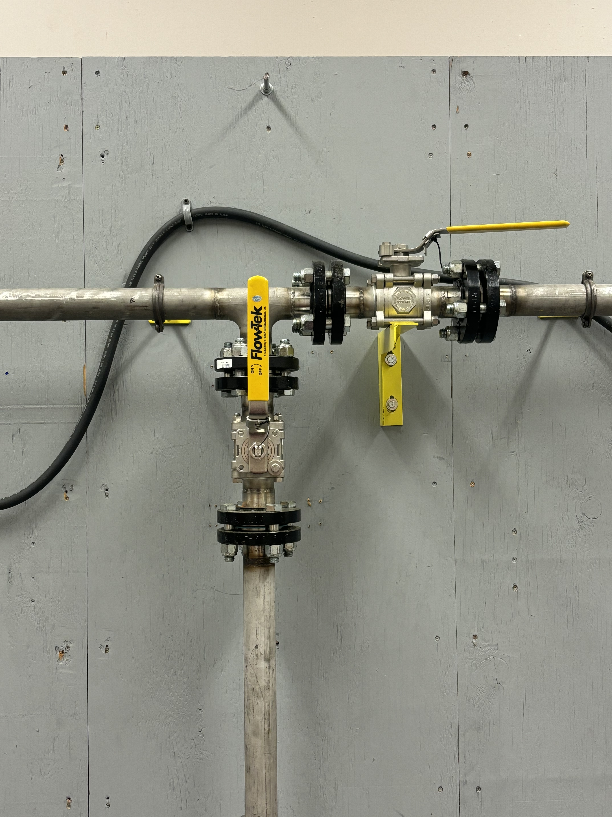
Flow Control Valves
Vertical valve shuts/opens bypass channel
Increases flow rate through heat source
Horizontal valve stops flow through heat source

Slide 7
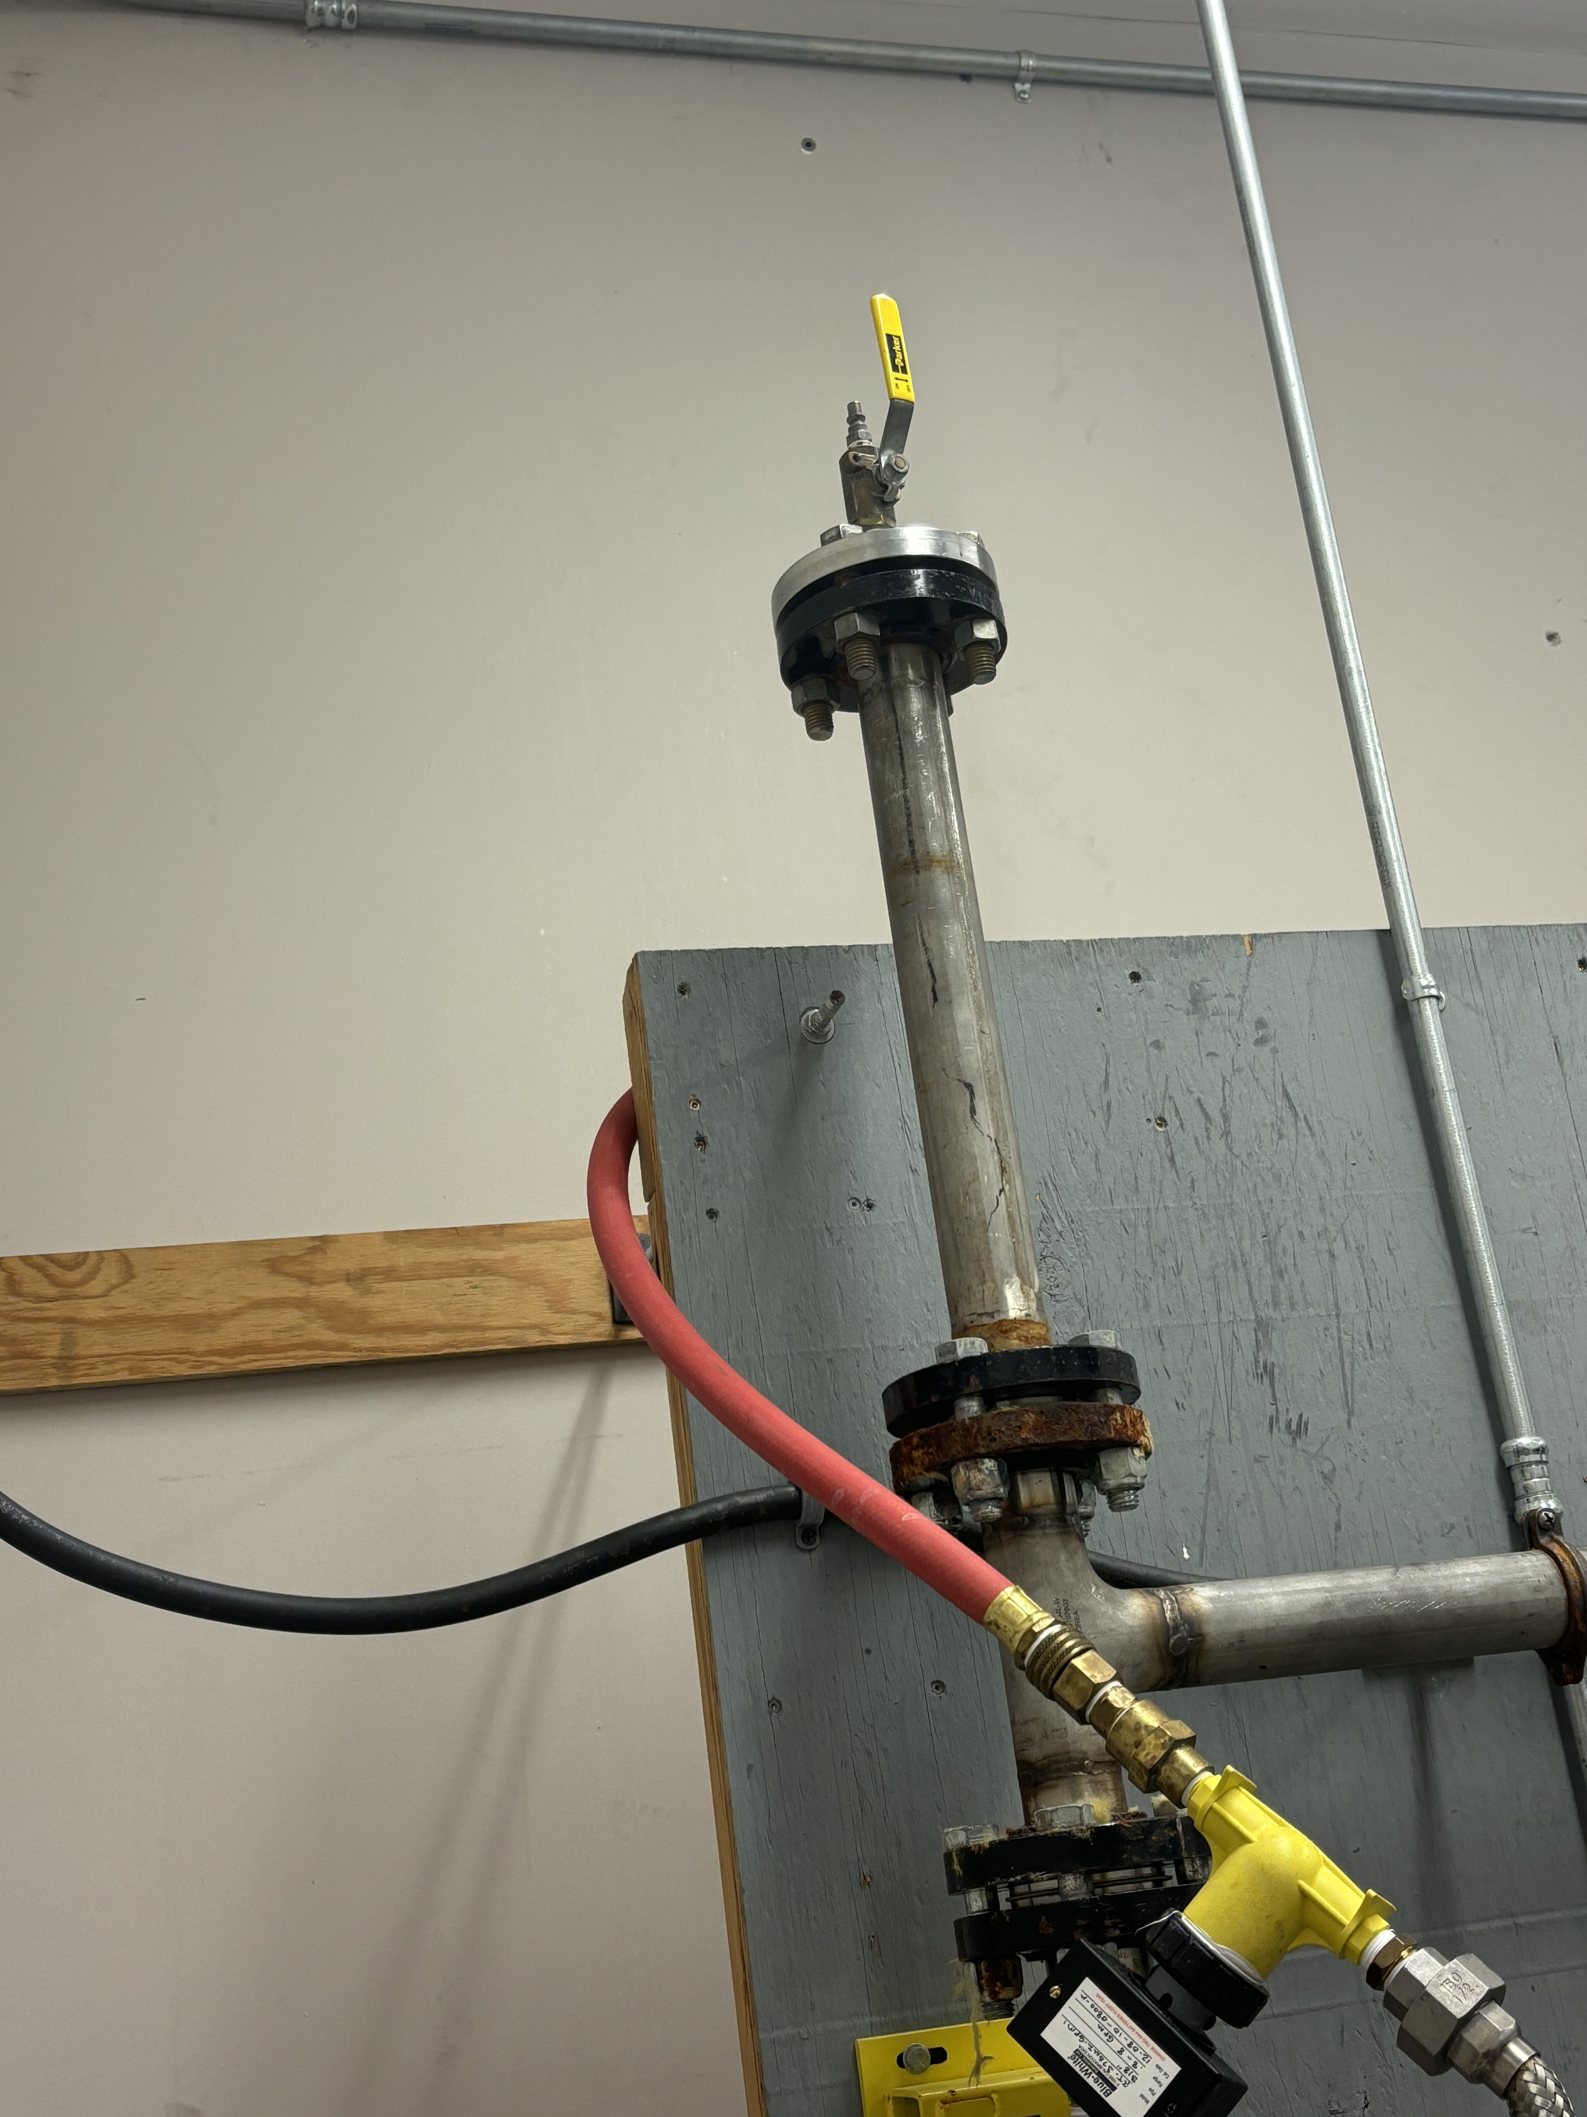
Pressurizer
Air Hose Attachment on top
Raises boiling point of water by pressurizing entire system w/ Air
Increases efficiency of real reactors

Slide 8
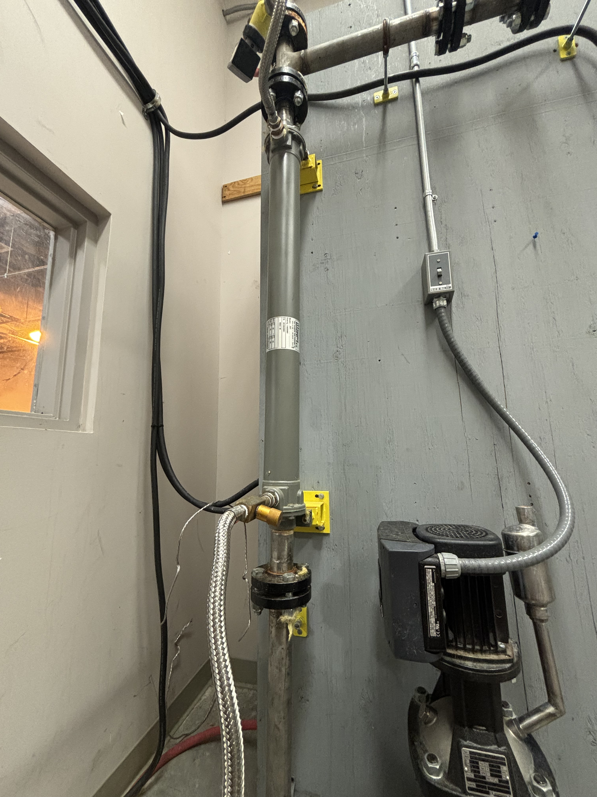
Heat Exchanger
Tap water pulls heat from the loop
Water expelled outside

Slide 9
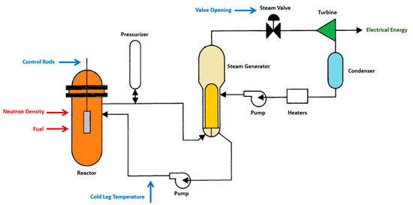
Typical PWR System

Slide 10
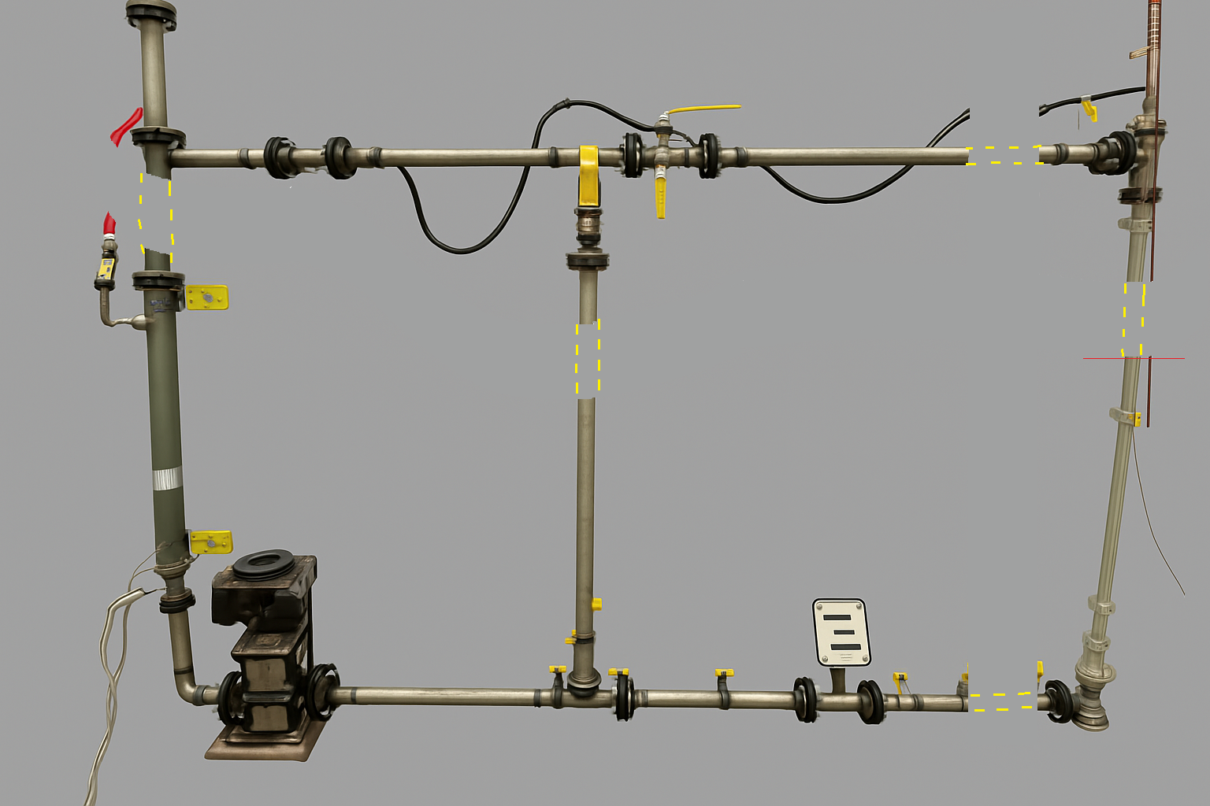
Plan for expansion to add measurement instruments
Add lengths of pipe to both horizontal and all three vertical pipes to Improve measurement capability at different locations along the loop

Slide 11
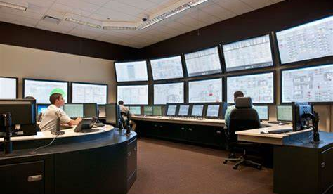
Plan to add 'Control Room'
Develop remote control and monitoring capabilities
Located in C004 or Nearby

Slide 12
Thank You for Your Time
Name: Matthew Whetham
Title: Undergrad, DME
Email: mwhetham@email.sc.edu
Lab GitHub: github.com/arts-laboratory

